Slide 1
Implementation on ODE-based C2 Continuous Surface Creation Technique
MSc Computer Animation & Visual Effects
Tutor : Lihua You
Pleader: Junheng Fang

Slide 2
CONTENTS
Introduction
Literature Review
Algorithm
Implementation
Conclusion
Mathematical Model
Solution to ODEs
Edge Continuities
Patch Separation
Interpolation
Patch Separation
Wireframe Extracting
Surface Creation
Skin Deformation
Background
Current Challenges
Research Significance
Related Works
Main Techniques
Significance
Expectation

Slide 3
Introduction
0 1
Background
Current Challenges
Research Significance
PART ONE

Slide 4
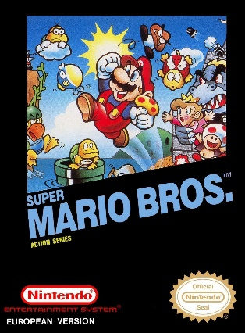



Introduction
Literature Review
Algorithm
Implementation
Conclusion
Background
Super Mario Bros.
Size: 64 KB
Platform: FC
Released in 1985
New Super Mario Bros.
Size: 10 MB
Platform: NDS
Released in 2006
Super Mario Bros.
Deluxe
Size: 342 KB
Platform: GBC
Released in 1999
New Super Mario Bros. U
Size: 2.5 GB
Platform: Wii U
Released in 2012

Slide 5

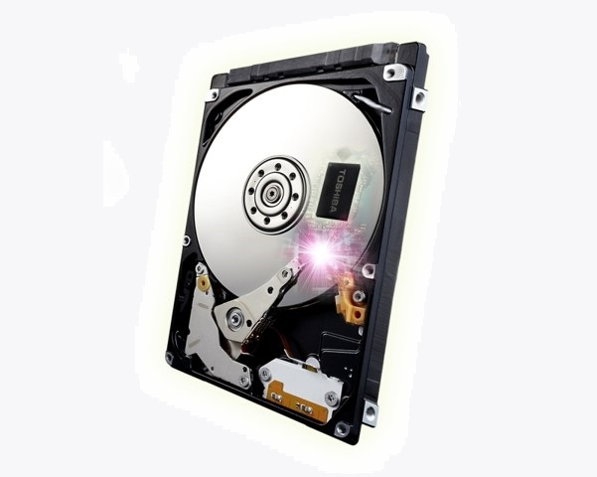
Introduction
Literature Review
Algorithm
Implementation
Conclusion
Current Challenges
Call of Duty: Infinite Warfare
Size: 130GB
Platform: PC
Released in 2016
Challenges
Borden on hard drives
Internet Transmission
Realism
Performance

Slide 6
Introduction
Literature Review
Algorithm
Implementation
Conclusion
Research Significance
Significance1
Significance2
Significance3
Less Data
Using a more data-saving method to create 3D models, compared with NUBRS and subdivision modelling.
Realism
Using a physics-based skin deformation approach to generate a more realistic facial expression changing animation.
Blending
Blend the surface creation method with skin deformation method to balance realism and performance.

Slide 7
Literature Review
0 2
Related Works
Main Techniques
PART TWO

Slide 8

Introduction
Literature Review
Algorithm
Implementation
Conclusion
Related Works
Reference
[1]Allen B., Curless B. and Popović Z., 2002. Articulated body deformation from range scan data. ACM Transactions on Graphics (TOG), 21(3), 612–619.
[2] Bian S., Deng Z., Chaudhry E., You L., Yang X., Guo L., Ugail H., Jin X., Xiao Z. and Zhang J. J., 2019. Efficient and realistic character animation through analytical physics-based skin deformation. Graphical Models, 104, 101035.
[3] Bian S., Maguire G., Kokke W., You L. and Zhang J. J., 2020. Efficient c2 continuous surface creation technique based on ordinary differential equation. Symmetry, 12(1), 38.
[4] Chaudhry E., You L. and Zhang J. J., 2010. Character skin deformation: A survey. In 2010 Seventh International Conference on Computer Graphics, Imaging and Visualization. IEEE, 41–48.
[5] Chaudhry E., You L., Jin X., Yang X. and Zhang J. J., 2013. Shape modeling for animated characters using ordinary differential equations. Computers & graphics, 37(6), 638–644.
[6] Debunne G., Desbrun M., Cani M.-P. and Barr A. H., 2001. Dynamic real-time deformations using space & time adaptive sampling. In Proceedings of the 28th annual conference on Computer graphics and interactive techniques, 31–36.
[7] Hamm J., Kohler C. G., Gur R. C. and Verma R., 2011. Automated facial action coding system for dynamic analysis of facial expressions in neuropsychiatric disorders. Journal of neuroscience methods, 200(2), 237–256.
[8] Magnenat-Thalmann N., Laperrire R. and Thalmann D., 1988. Jointdependent local deformations for hand animation and object grasping. In In Proceedings on Graphics interface’88. Citeseer.

Slide 9
Introduction
Literature Review
Algorithm
Implementation
Conclusion
Related Works
Reference
[10] Nealen A., Müller M., Keiser R., Boxerman E. and Carlson M., 2005. Physically based deformable models in computer graphics. In EUROGRAPHICS 2005 STAR–STATE OF THE ART REPORT. Citeseer.
[11] Paul E., Joseph C H. and Wallace V F., 2002. Facial action coding system. Salt Lake City : A Human Face
[12] Piegl L. and Tiller W., 2012. The NURBS book. Springer Science & Business Media.
[13] Platt S. M. and Badler N. I., 1981. Animating facial expressions. In Proceedings of the 8th annual conference on Computer graphics and interactive techniques, 245–252.
[14] Russo M., 2006. Polygonal modeling: basic and advanced techniques. Jones & Bartlett Learning.
[15] Sederberg T. W. and Parry S. R., 1986. Free-form deformation of solid geometric models. In Proceedings of the 13th annual conference on Computer graphics and interactive techniques, 151–160.
[16] You L., Yang X., You X. Y., Jin X. and Zhang J. J., 2010. Shape manipulation using physically based wire deformations. Computer Animation and Virtual Worlds, 21(3-4), 297–309.
[17] You L., Yang X., Pachulski M. and Zhang J. J., 2007. Boundary constrained swept surfaces for modelling and animation. In Computer Graphics Forum, volume 26. Wiley Online Library, 313–322.

Slide 10
Introduction
Literature Review
Algorithm
Implementation
Conclusion
Related Works
Surface Creation Techniques
polygon modelling
subdivision modelling
Russo(2006)
exhibit details and branches
assign UV texture coordinates
easily generate hard edges
approximate curved surfaces reduces the precision
Cirak F, et al(2002)
easily create complicated geometry with more efficiently rendering
insufficient underlying parametrization makes it hard to elaborate the accuracy
A
B
Surface
Creation
D
C
NURBS modelling
in-curved network modelling
Piegl and Tiller(2012)
create curved objects with smoother surfaces
readily edit the patches with fewer control curves
manual operation in stitching adjacent patches
Várady et al. (2012)
provide further shape controls
particularly used to revise the inside of transfinite patches

Slide 11
Introduction
Literature Review
Algorithm
Implementation
Conclusion
Related Works
Surface Creation Techniques
physics-based
ODE-based
You et al. (2007)
ODE-based sweeping surfaces
You et al. (2010)
ODE-based surface deformations
Chaudhry et al. (2013)
ODE-based sweeping blending
provide users with a higher-level control to manipulate the surfaces via parameters and boundary condition
Nealen et al. (2005)
finite difference method
mass-spring system
reduced deformable models using modal analysis
provide the physical laws underlying its surface deformation

Slide 12
Introduction
Literature Review
Algorithm
Implementation
Conclusion
Related Works
Skin Deformation Techniques
Platt and Badler (1981)
mass-spring system
interactive animation of deformable models
Debunne et al. (2001)
finite element method (FEM)
simulation of elastics
Chaudhry et al. (2010)
finite volume method (FVM)
simulate the deformable movement of skeletal muscles
Bian et al. (2019)
PDE-based approach
high efficiency and physically realistic
Sederberg and Parry (1986)
free form deformation (FFDs)
simplicity and modelling speed
Magnenat-Thalmann et al.(1988)
joint-related approaches
introduces vertex weights for smooth transformation of bones
Allen et al. (2002)
example-based techniques
use existing poses as the base
geometric
deformation
physics-based
deformation

Slide 13
Algorithm
0 3
Mathematical Model
Solution to ODEs
Edge Continuities
Patch Separation
Interpolation
PART THREE

Slide 14
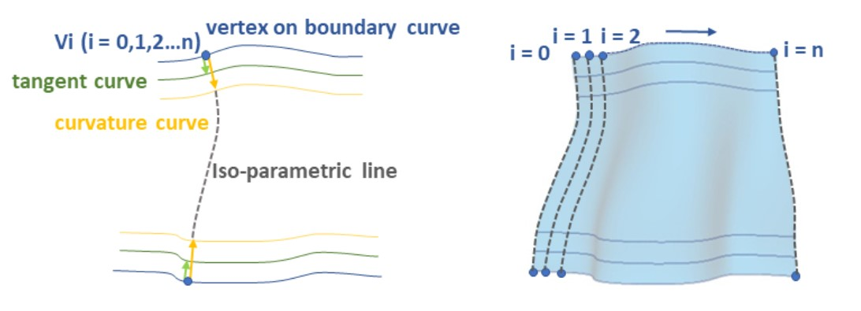
Introduction
Literature Review
Algorithm
Implementation
Conclusion
Reference
Bian S., Maguire G., Kokke W., You L. and Zhang J. J., 2020.
Efficient c2 continuous surface creation technique based on ordinary differential equation
6 curves to control the shape of surface patches:
two boundary curves: representing the position of the patch
four control curves: describing the tangent and curvature of each vertex on the boundary curves to calculate the iso-parametric lines

Slide 15
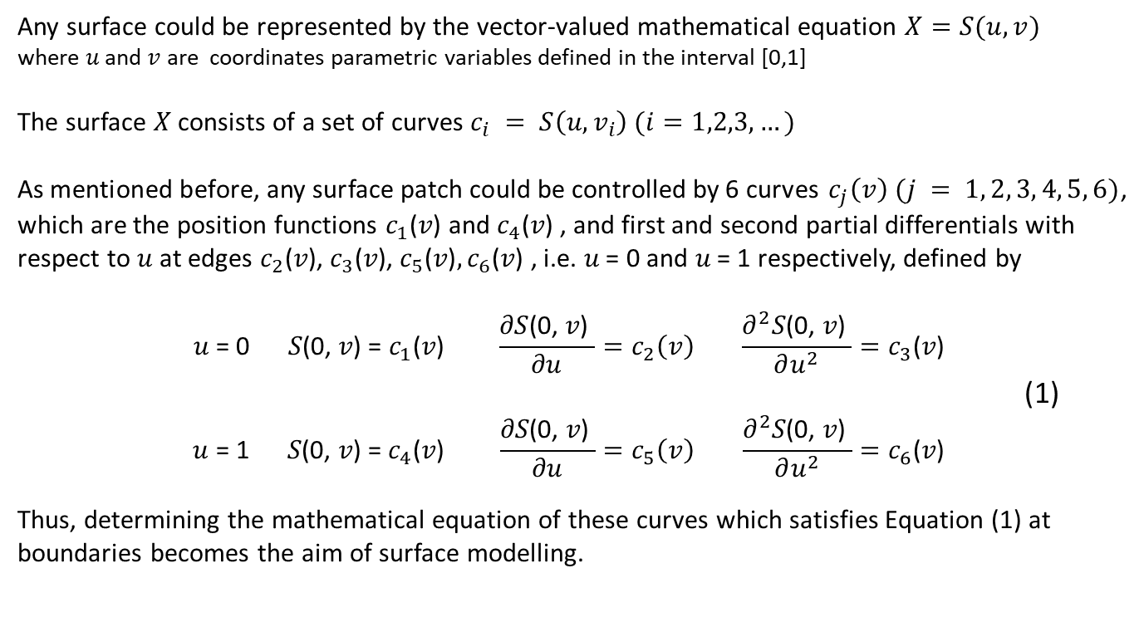
Introduction
Literature Review
Algorithm
Implementation
Conclusion
Mathematical Model
Any surface could be represented by the vector-valued mathematical equation $X=S(u,v)$
where $u$ and $v$ are coordinates parametric variables defined in the interval [0,1]
The surface $X$ consists of a set of curves $c_{i} = S\left(u,v_{i}\right) (i=1,2,3,…)$
As mentioned before, any surface patch could be controlled by 6 curves $c_{j}\left(v\right) (j = 1, 2, 3, 4, 5, 6)$,
which are the position functions $c_{1}\text{(}\text{v}\text{)}$ and $c_{4}\text{(}\text{v}\text{) }$, and first and second partial differentials with respect to 𝑢 at edges $c_{2}\text{(}\text{v}\text{)}\text{,} c_{3}\text{(}\text{v}\text{)}\text{,} c_{5}\text{(}\text{v}\text{)}, c_{6}\text{(}\text{v}\text{) }$, i.e. 𝑢 = 0 and 𝑢 = 1 respectively, defined by
$$\text{u} \text{= 0} \text{S}\text{(0, }\text{v}\text{) = }c_{1}\text{(}\text{v}\text{) } \frac{\text{∂}\text{S}\text{(0, }\text{v}\text{)} }{\text{∂}\text{u}}=c_{2}\left(v\right) \frac{{\text{∂}}^{2}\text{S}\text{(0, }\text{v}\text{)} }{\text{∂}u^{2}}=c_{3}\text{(}\text{v}\text{)}$$
(1)
$$\text{u} \text{= }\text{1 } \text{S}\text{(0, }\text{v}\text{) = }c_{4}\text{(}\text{v}\text{) } \frac{\text{∂}\text{S}\text{(0, }\text{v}\text{)} }{\text{∂}\text{u}}=c_{5}\left(v\right) \frac{{\text{∂}}^{2}\text{S}\text{(0, }\text{v}\text{)} }{\text{∂}u^{2}}=c_{6}\text{(}\text{v}\text{)}$$
Thus, determining the mathematical equation of these curves which satisfies Equation (1) at boundaries becomes the aim of surface modelling.

Slide 16
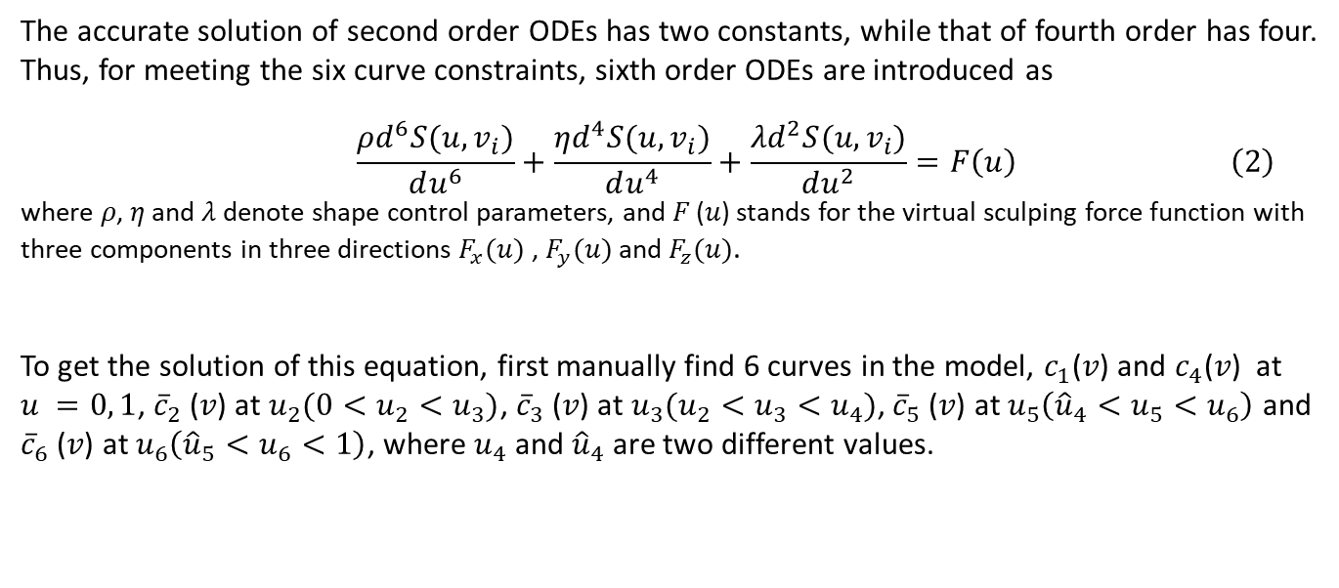
Introduction
Literature Review
Algorithm
Implementation
Conclusion
Mathematical Model
The accurate solution of second order ODEs has two constants, while that of fourth order has four.
Thus, for meeting the six curve constraints, sixth order ODEs are introduced as
$$\frac{ρd^{6}S(u,v_{i})}{du^{6}}+\frac{ηd^{4}S(u,v_{i})}{du^{4}}+\frac{λd^{2}S(u,v_{i})}{du^{2}}=F\left(u\right) \left(2\right)$$
where 𝜌, 𝜂 and 𝜆 denote shape control parameters, and 𝐹 (𝑢) stands for the virtual sculping force function with three components in three directions $F_{x}(u)$ , $F_{y}(u)$ and $F_{z}(u)$.
To get the solution of this equation, first manually find 6 curves in the model, $c_{1}\text{(}\text{v}\text{)}$ and $c_{4}\text{(}\text{v}\text{) }$ at $u =0, 1$, ${\overline{c}}_{2} \text{(}\text{v}\text{)}$ at $u_{2}(0<u_{2}<u_{3})$, ${\overline{c}}_{3} \text{(}\text{v}\text{)}$ at $u_{3}(u_{2}<u_{3}<u_{4})$, ${\overline{c}}_{5} \text{(}\text{v}\text{)}$ at $u_{5}\left({\hat{u}}_{4}<u_{5}<u_{6}\right)$ and ${\overline{c}}_{6} \text{(}\text{v}\text{)}$ at $u_{6}\left({\hat{u}}_{5}<u_{6}<1\right)$, where $u_{4}$ and ${\hat{u}}_{4}$ are two different values.

Slide 17
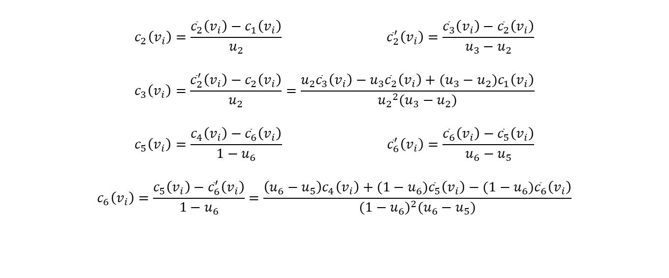
Introduction
Literature Review
Algorithm
Implementation
Conclusion
Mathematical Model
The next step is to use the 6 curves to compute the first and second differentials $c_{j}\left(v_{i}\right) \left(j=2,3,5,6\right)$. using the following forward difference formula:
$$c_{2}\left(v_{i}\right)=\frac{{\overline{c}}_{2}\left(v_{i}\right)−c_{1}\left(v_{i}\right)}{u_{2}} {\overline{c}}_{2}^{′}\left(v_{i}\right)=\frac{{\overline{c}}_{3}\left(v_{i}\right)−{\overline{c}}_{2}\left(v_{i}\right)}{u_{3}−u_{2}}$$
$$c_{3}\left(v_{i}\right)=\frac{{\overline{c}}_{2}^{′}\left(v_{i}\right)−c_{2}\left(v_{i}\right)}{u_{2}}=\frac{u_{2}{\overline{c}}_{3}\left(v_{i}\right)−u_{3}{\overline{c}}_{2}\left(v_{i}\right)+({u_{3}−u}_{2})c_{1}\left(v_{i}\right)}{{u_{2}}^{2}({u_{3}−u}_{2})}$$
$$c_{5}\left(v_{i}\right)=\frac{c_{4}\left(v_{i}\right)−{\overline{c}}_{6}\left(v_{i}\right)}{{1−u}_{6}} {\overline{c}}_{6}^{′}\left(v_{i}\right)=\frac{{\overline{c}}_{6}\left(v_{i}\right)−{\overline{c}}_{5}\left(v_{i}\right)}{u_{6}−u_{5}}$$
$$c_{6}\left(v_{i}\right)=\frac{c_{5}\left(v_{i}\right)−{\overline{c}}_{6}^{′}\left(v_{i}\right)}{{1−u}_{6}}=\frac{\left(u_{6}−u_{5}\right)c_{4}\left(v_{i}\right)+({1−u}_{6}){\overline{c}}_{5}\left(v_{i}\right)−({1−u}_{6}){\overline{c}}_{6}\left(v_{i}\right)}{{({1−u}_{6})}^{2}({u_{6}−u}_{5})}$$
Since $v_{i}$ monotonously changes in the interval [0, 1], the tangents and curvature of the boundary are continuous functions of the parametric variable $v$, these curves $c_{j}\left(v_{i}\right)$can be written as $c_{j}\left(v\right)$.

Slide 18
Introduction
Literature Review
Algorithm
Implementation
Conclusion
Solution to ODEs
Since we only use the complementary solution of Equation (2) to manipulate the surface, whilst the particular solution allows further deformation control with $F\left(u\right)$, Equation (2) could be written as
$$\frac{ρd^{6}S(u,v_{i})}{du^{6}}+\frac{ηd^{4}S(u,v_{i})}{du^{4}}+\frac{λd^{2}S(u,v_{i})}{du^{2}}=0 \left(3\right)$$
Introducing $\overline{S}\left(u,v_{i}\right)=\frac{d^{2}S\left(u,v_{i}\right)}{du^{2}}$ into Equation (3), we can get
$$\frac{ρd^{4}\overline{S}(u,v_{i})}{du^{4}}+\frac{ηd^{2}\overline{S}(u,v_{i})}{du^{2}}+λ\overline{S}(u,v_{i})=0 \left(4\right)$$
Then considering ${\overline{s}}_{φ}\left(u,v_{i}\right)=e^{ru} (φ=x,y,z)$ into Equation (4), we can get
$$ρr^{4}+ηr^{2}+λ=0 \left(5\right)$$
Substituting $q$ with $r^{2}$, we can get a quadratic equation
$$ρq^{2}+ηq+λ=0 \left(6\right)$$

Slide 19
Introduction
Literature Review
Algorithm
Implementation
Conclusion
Solution to ODEs
whose roots are
$$q_{1,2}=\frac{−η(1±\sqrt{1−\frac{4ρλ}{η^{2}}})}{2ρ}$$
Introducing $ξ_{1,2}=\sqrt{η(1±\sqrt{1−4ρλ/η^{2}})/(2ρ)}$ into the ${q=r}^{2}$, we can get
$$r_{1,2}=±{iξ}_{1} r_{3,4}=±{iξ}_{2}$$
Thus, the complementary solution to Equation (4) could be written as
$$S\left(u,v_{i}\right)={\overline{b}}_{1}cosξ_{1}u+{\overline{b}}_{2}sinξ_{1}u+{\overline{b}}_{3}cosξ_{2}u+{\overline{b}}_{4}sinξ_{2}u (7)$$
where $b_{k}(k=1,2,…,6)$ stands for different constants

Slide 20
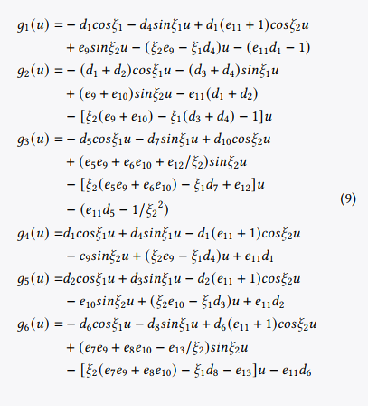
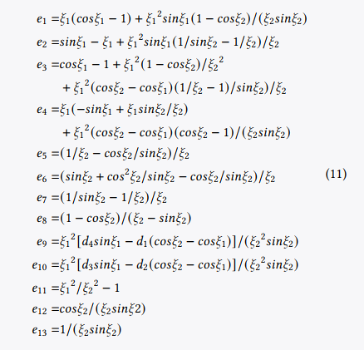
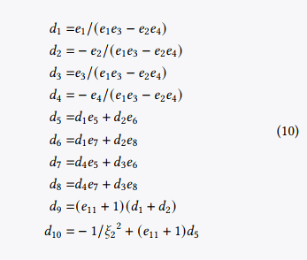
Introduction
Literature Review
Algorithm
Implementation
Conclusion
Solution to ODEs
Substituting Equation (7) into Equation (1) and putting the results back into Equation (7), a function of a 3D parametric surface with boundary constraints are achieved
$S\left(u,v_{i}\right)=g_{1}c_{1}\left(v\right)+g_{2}c_{2}(v)$+ $g_{3}c_{3}(v)$+ $g_{4}c_{4}(v)$+ $g_{5}c_{5}(v)$+ $g_{6}c_{6}\left(v\right) (8)$
where

Slide 21
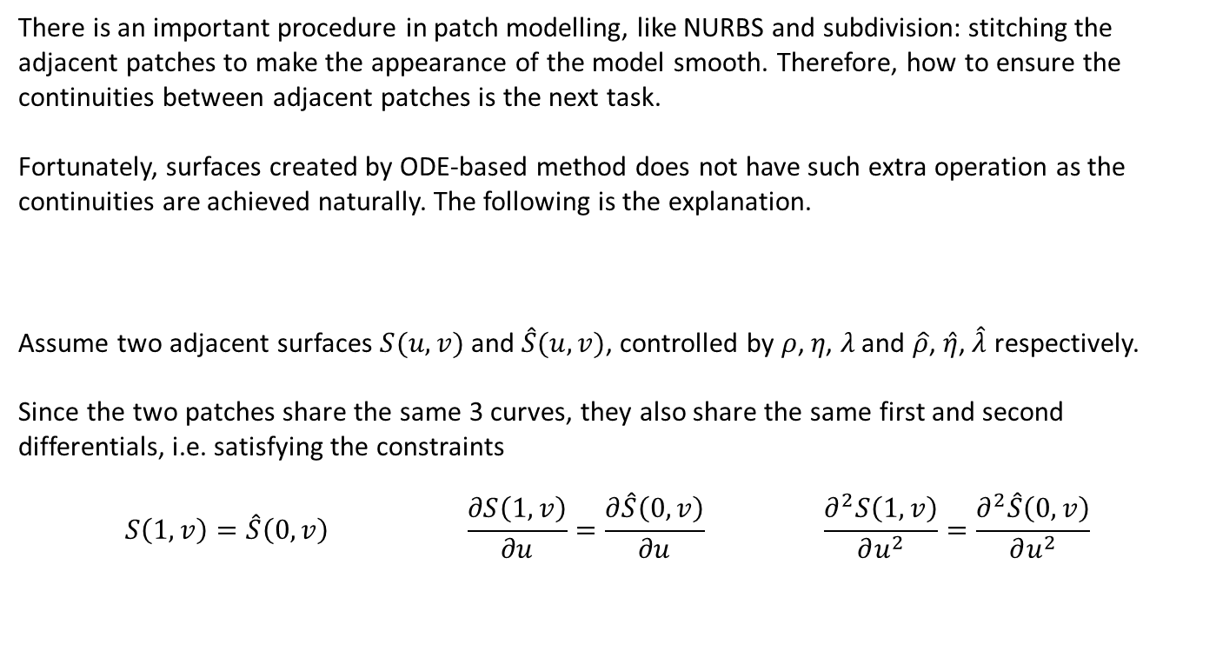
Introduction
Literature Review
Algorithm
Implementation
Conclusion
Edge Continuities
There is an important procedure in patch modelling, like NURBS and subdivision: stitching the adjacent patches to make the appearance of the model smooth. Therefore, how to ensure the continuities between adjacent patches is the next task.
Fortunately, surfaces created by ODE-based method does not have such extra operation as the continuities are achieved naturally. The following is the explanation.
Assume two adjacent surfaces $S(u,v)$ and $\hat{S}(u,v)$, controlled by 𝜌, 𝜂, 𝜆 and $\hat{ρ}$, $\hat{η}$, $\hat{λ}$ respectively.
Since the two patches share the same 3 curves, they also share the same first and second differentials, i.e. satisfying the constraints
$$S\left(1,v\right)=\hat{S}\left(0,v\right) \frac{∂S\left(1,v\right)}{∂u}=\frac{∂\hat{S}\left(0,v\right)}{∂u} \frac{∂^{2}S\left(1,v\right)}{∂u^{2}}=\frac{∂^{2}\hat{S}\left(0,v\right)}{∂u^{2}}$$
Continuity in parametric direction u

Slide 22
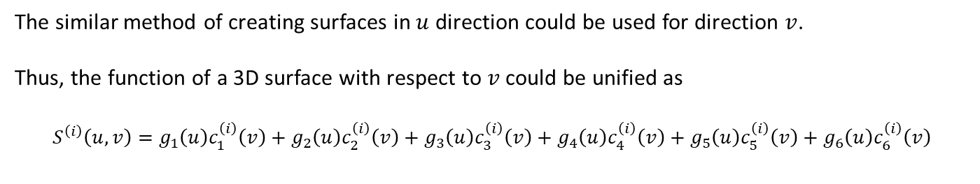
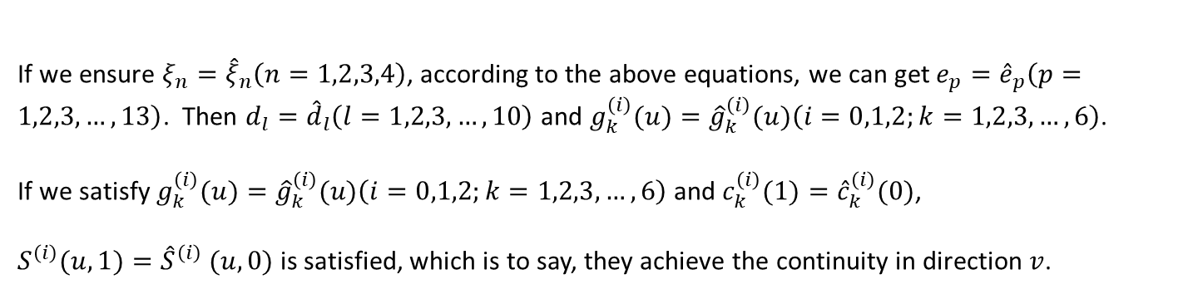
Introduction
Literature Review
Algorithm
Implementation
Conclusion
Edge Continuities
Continuity in parametric direction v
The similar method of creating surfaces in $u$ direction could be used for direction $v$.
Thus, the function of a 3D surface with respect to $v$ could be unified as
$$S^{\left(i\right)}\left(u,v\right)=g_{1}\left(u\right)c_{1}^{\left(i\right)}\left(v\right)+g_{2}\left(u\right)c_{2}^{\left(i\right)}\left(v\right)+g_{3}\left(u\right)c_{3}^{\left(i\right)}\left(v\right)+g_{4}\left(u\right)c_{4}^{\left(i\right)}\left(v\right)+g_{5}\left(u\right)c_{5}^{\left(i\right)}\left(v\right)+g_{6}\left(u\right)c_{6}^{\left(i\right)}\left(v\right)$$
where $i=0,1,2$ stands for the position, first and second differentials in direction $v$ respectively.
If we ensure $ξ_{n}={\hat{ξ}}_{n}\left(n=1,2,3,4\right)$, according to the above equations, we can get $e_{p}={\hat{e}}_{p}\left(p=1,2,3,…,13\right)$. Then $d_{l}={\hat{d}}_{l}\left(l=1,2,3,…,10\right)$ and $g_{k}^{\left(i\right)}(u)={\hat{g}}_{k}^{\left(i\right)}(u)\left(i=0,1,2;k=1,2,3,…,6\right)$.
If we satisfy $g_{k}^{\left(i\right)}(u)={\hat{g}}_{k}^{\left(i\right)}(u)\left(i=0,1,2;k=1,2,3,…,6\right)$ and $c_{k}^{\left(i\right)}(1)={\hat{c}}_{k}^{\left(i\right)}(0)$,
$S^{\left(i\right)}(u,1)={\hat{S}}^{\left(i\right)} (u,0)$ is satisfied, which is to say, they achieve the continuity in direction $v$.

Slide 23
Introduction
Literature Review
Algorithm
Implementation
Conclusion
Patch Separation
Paul et al. (2002) have provided the Facial Action Coding System (FACS) to use corresponding parameters to control disparate face shapes.
Hamm et al. (2011) claimed that, the facial appearance could be used to encode the action of each facial muscles with marginally imperative changes.
Furthermore, any anatomically possible facial expression could be encoded by FACS through deconstructing it into temporal segments and action units (Freitas-Magalhães 2013), which could be used for further interpolation to adapt to any intelligent environment.
Based on this system, the sketched curves are used for decomposing the patches of detailed models.

Slide 24

Introduction
Literature Review
Algorithm
Implementation
Conclusion
Interpolation
In this report, a physics-based interpolation method based on Newton second law $ma=f$
is used for creating keyframe models to form a simple animation.
$$a=\frac{d^{2}x}{dt^{2}} ⇒ m\frac{d^{2}x^{\left(i\right)}}{dt^{2}}=f^{\left(i\right)}$$
Assume two different models defined by polygon vertices ${\overline{x}}_{n}$ and ${\overset{̿}{x}}_{n}(n=1,2,3,…,N)$ and position change $x$ at time $t$ is $x_{n}(n=1,2,3,…,N)$. We can get
$$t=0 x_{n}^{(i)}=0, \frac{{dx}_{n}^{(i)}}{dt}=0$$
$$t=1 x_{n}^{(i)}={\overset{̿}{x}}_{n}^{(i)}−{\overline{x}}_{n}^{(i)}(n=1,2,3,…,N)$$
Then we can get
$$m\frac{d^{2}x_{n}^{(i)}}{dt^{2}}=f_{n}^{(i)} ⇒ \frac{d^{2}x_{n}^{(i)}}{dt^{2}}=\frac{f_{n}^{(i)}}{m} ⇒ x_{n}^{(i)}=\frac{f_{n}^{(i)}t^{2}}{2m}+c_{0}t+c_{1}$$
where $c_{0}$ and $c_{1}$ are unknown constants.

Slide 25
Introduction
Literature Review
Algorithm
Implementation
Conclusion
Interpolation
If we solve for the two unknown constants and the external force $f_{n}^{(i)}$, we have
$$c_{0} \text{=} c_{1}=0$$
$$f_{n}^{(i)}=2m[{\overset{̿}{x}}_{n}^{(i)}−{\overline{x}}_{n}^{(i)}]$$
Then by putting the solutions into the equation, we can get
$$x_{n}^{(i)}=[{\overset{̿}{x}}_{n}^{\left(i\right)}−{\overline{x}}_{n}^{\left(i\right)}]t^{2}$$
Finally, we can get the coordinate information of interpolated vertices ${\hat{x}}_{n}^{(i)}$
$${\hat{x}}_{n}^{(i)}={\overline{x}}_{n}^{\left(i\right)}+[{\overset{̿}{x}}_{n}^{\left(i\right)}−{\overline{x}}_{n}^{\left(i\right)}]t^{2}$$

Slide 26
Implementation
0 4
Patch Separation
Wireframe Extracting
Surface Creation
Skin Deformation
PART FOUR

Slide 27
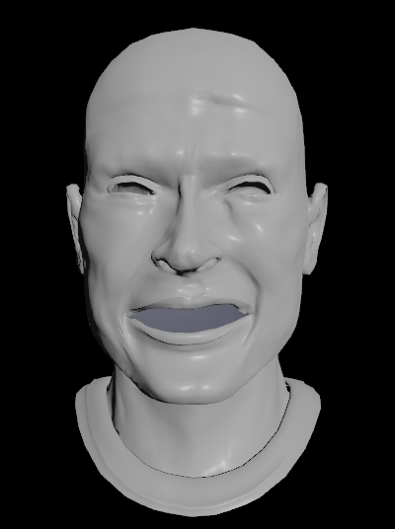
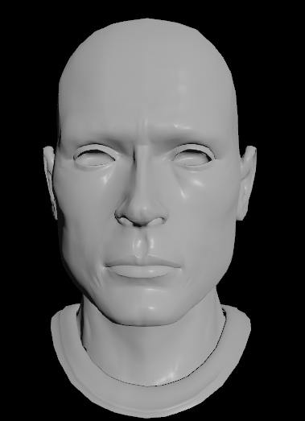
Introduction
Literature Review
Algorithm
Implementation
Conclusion
Patch Separation
To demonstrate the result of the implementation, two face models in the same topological structure with different expressions.

Slide 28
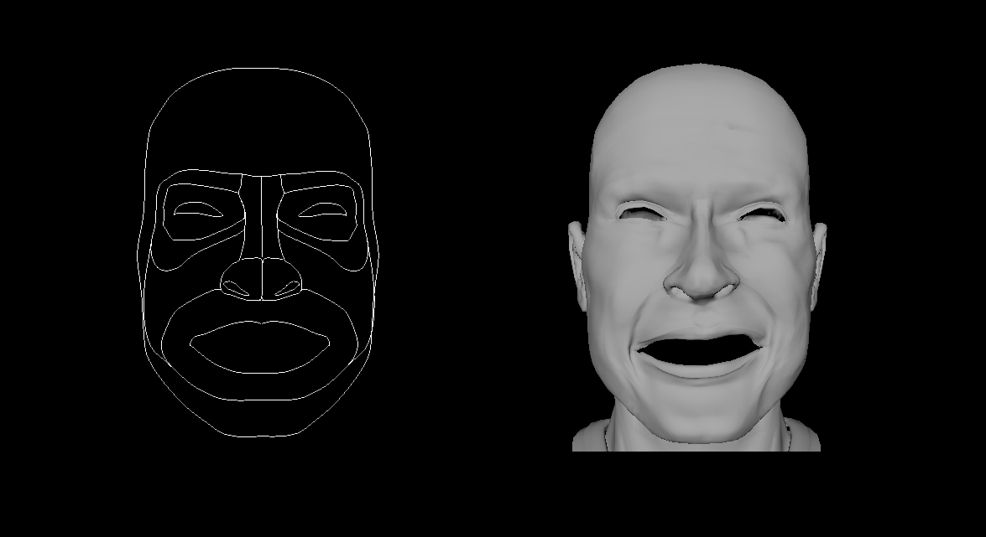
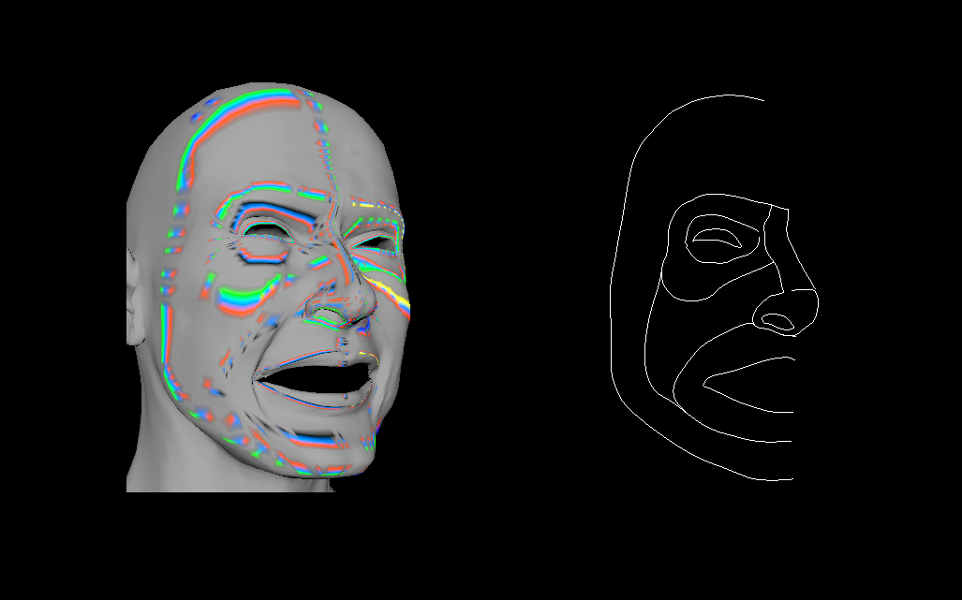
Introduction
Literature Review
Algorithm
Implementation
Conclusion
Patch Separation
I separate the face model into 7 patches: eye socket, eye bone, nose bridge, nostril, cheek, mouth and outer face frame.

Slide 29
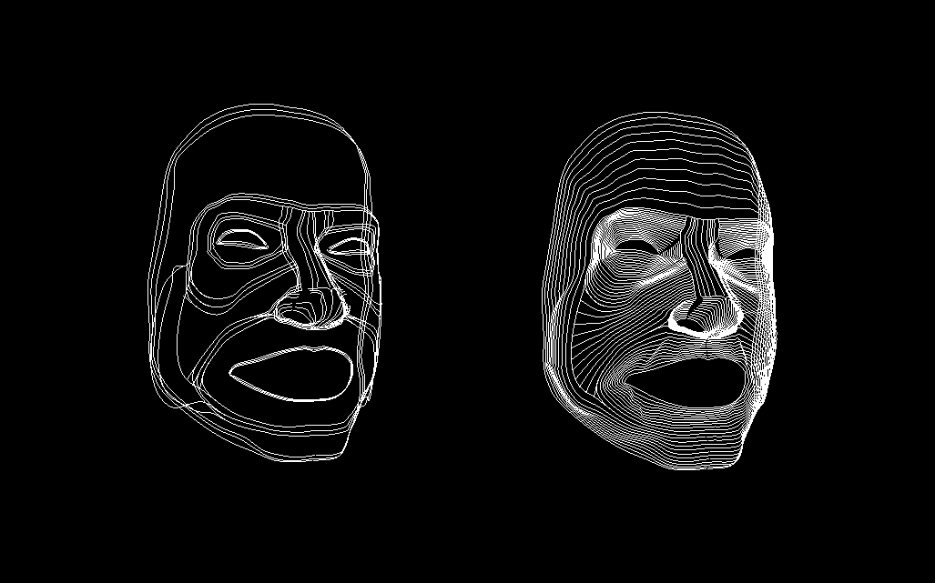
Introduction
Literature Review
Algorithm
Implementation
Conclusion
Wireframe Extracting
After extracting the wireframes of two models, Bian’s ODE-based surface creation technique is used to recreate the face model.

Slide 30
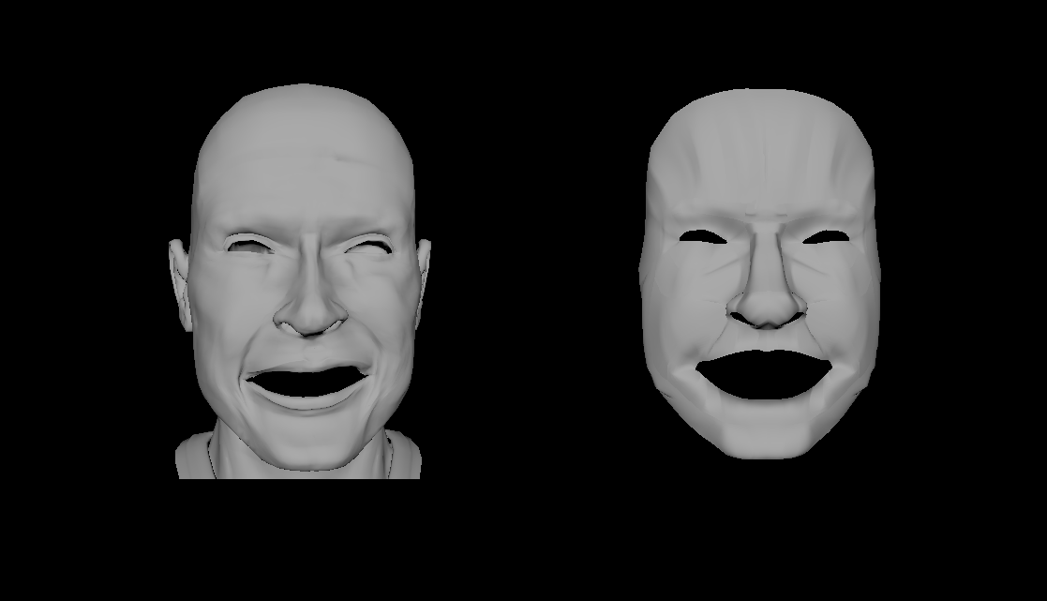
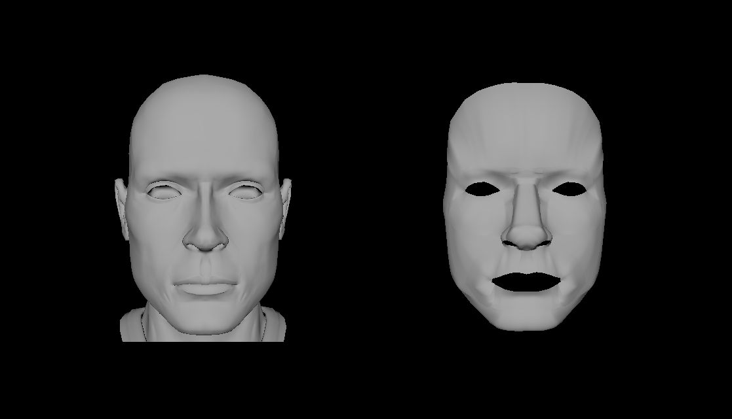
Introduction
Literature Review
Algorithm
Implementation
Conclusion
Surface Creation
Comparison between the original and recreated models

Slide 31
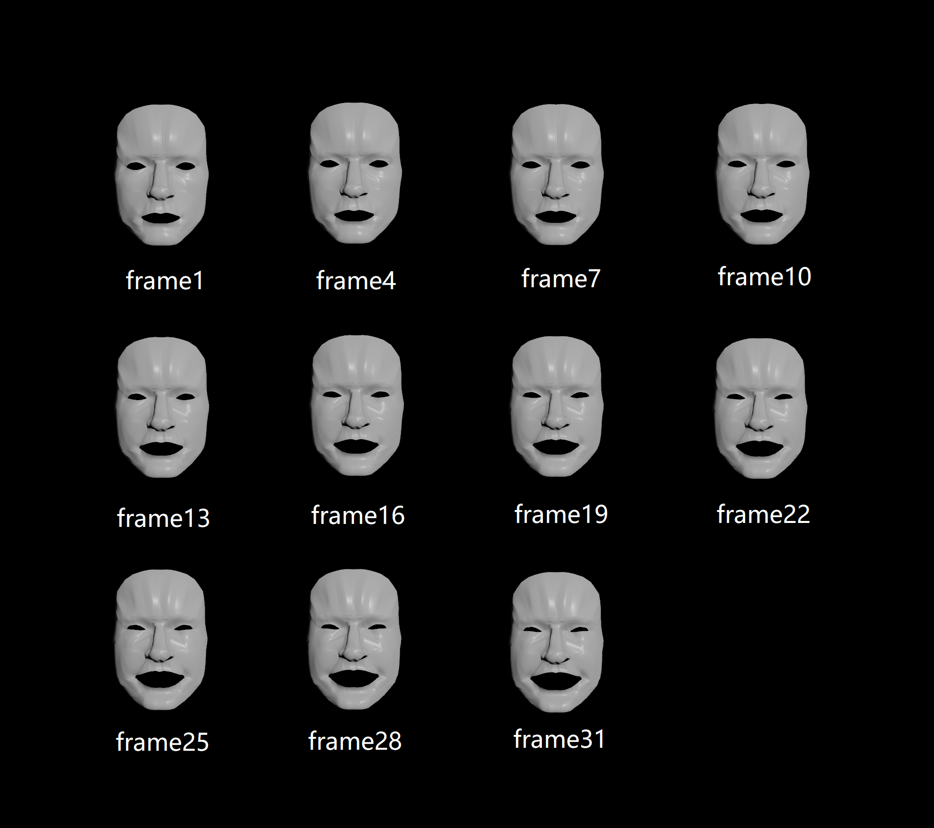
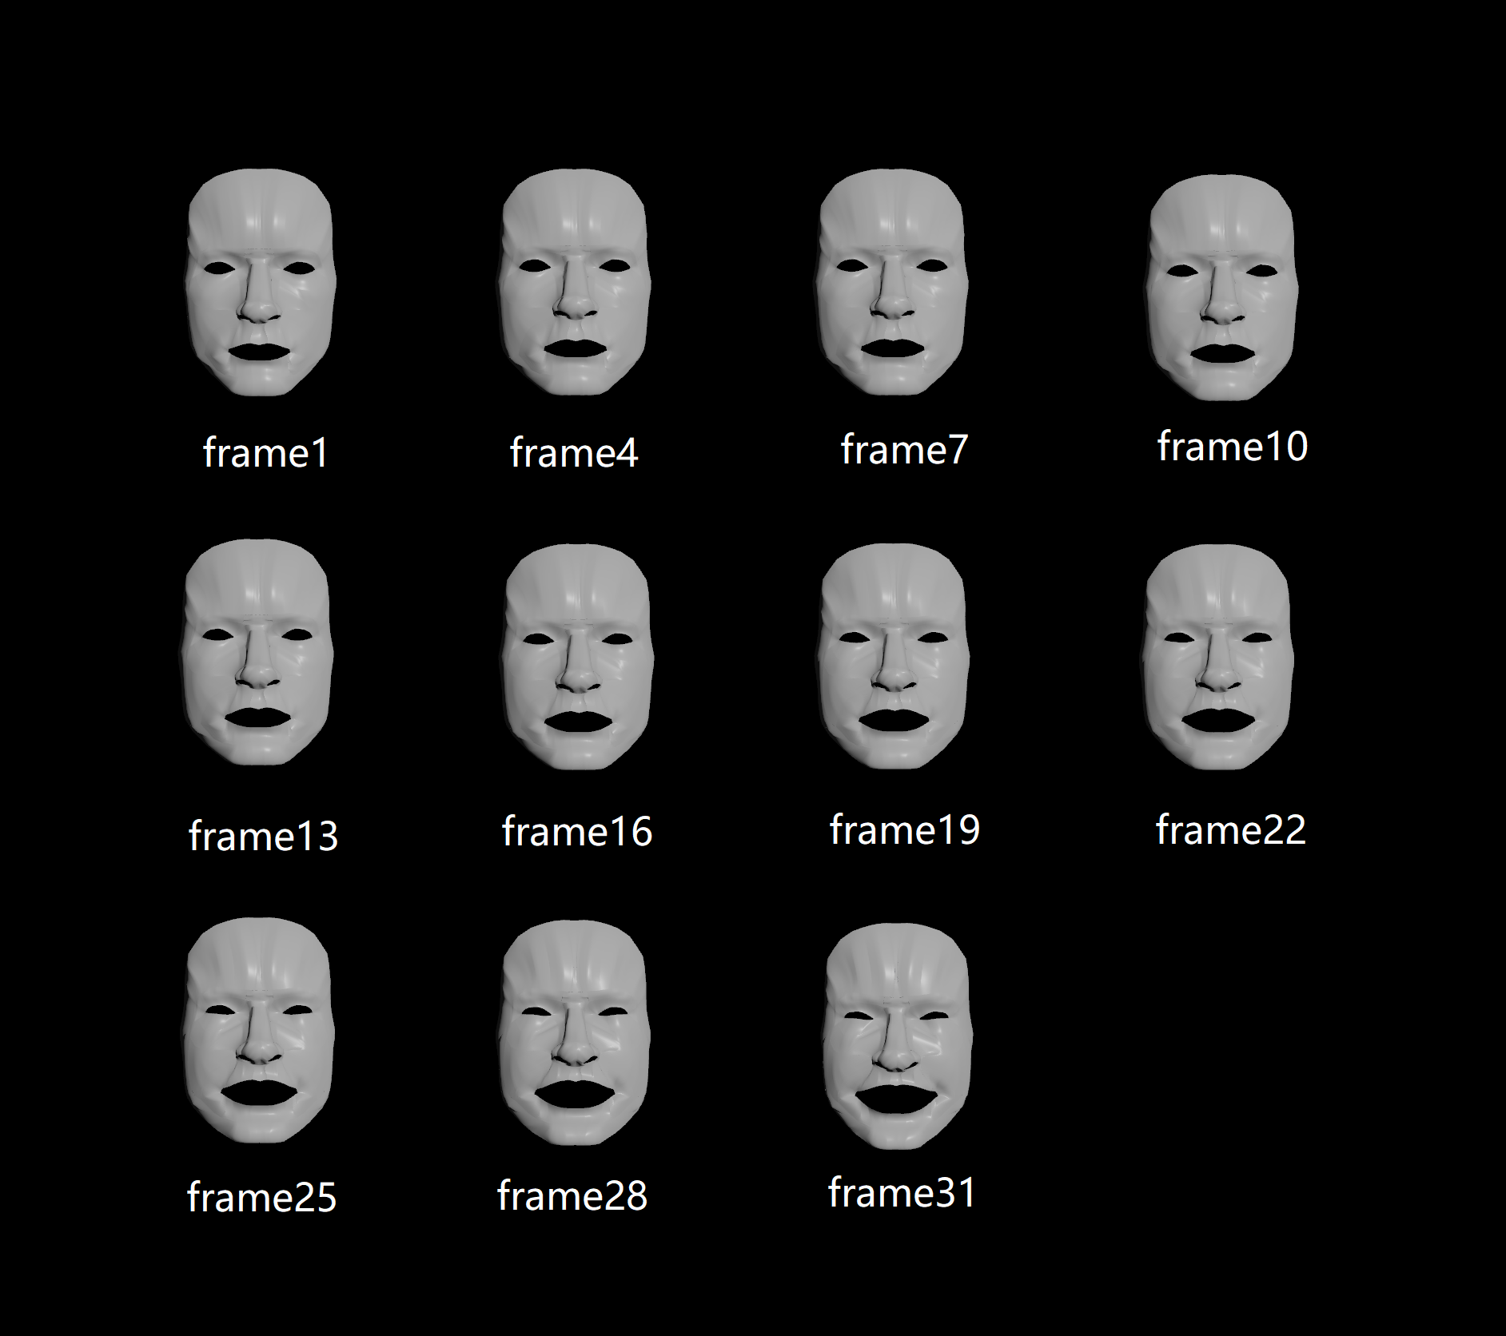
Introduction
Literature Review
Algorithm
Implementation
Conclusion
Skin Deformation
I used the linear interpolation and Newton interpolation as comparison, to show the feasibility of the ODE-based technique applied in facial deforming animation and the better result of physics-based skin deformation approach compared with the geometric one.
Linear Interpolation
Newton Interpolation

Slide 32
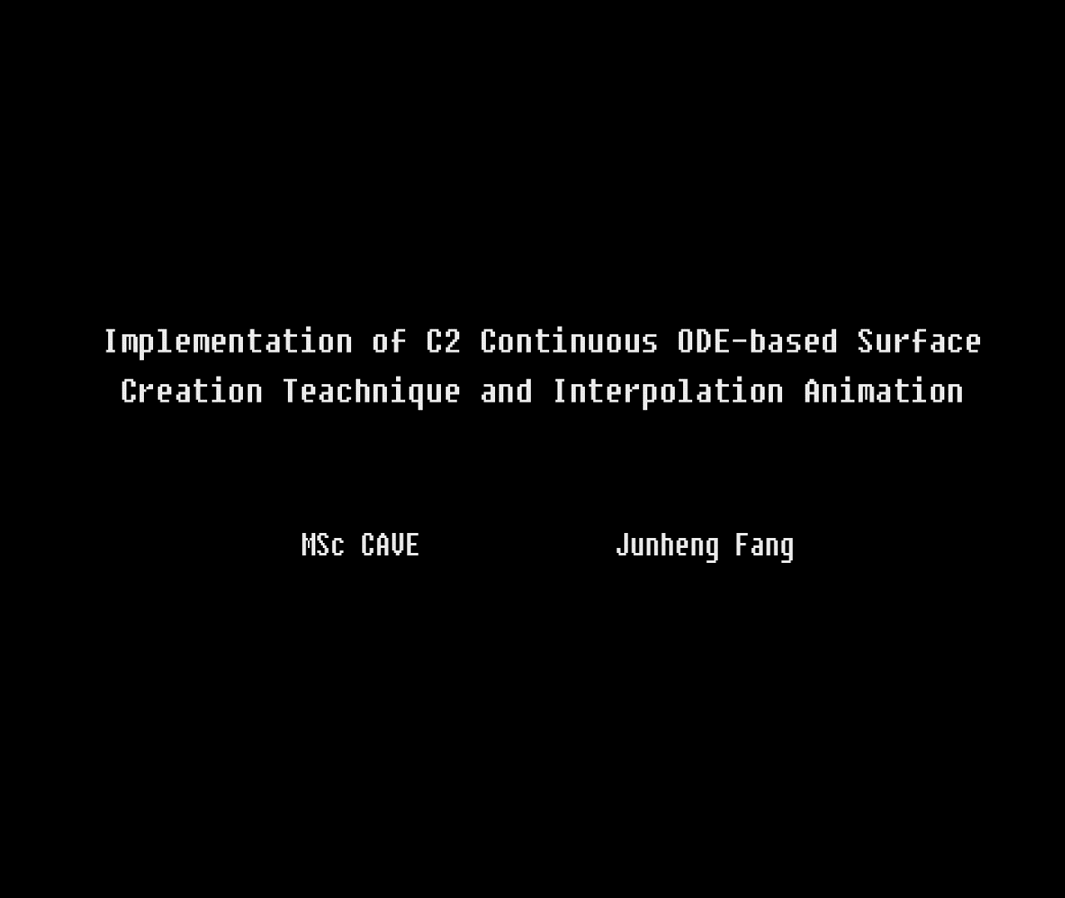
Introduction
Literature Review
Algorithm
Implementation
Conclusion
Skin Deformation

Slide 33
Conclusion
0 5
Significance
Expectation
PART FIVE

Slide 34
Introduction
Literature Review
Algorithm
Implementation
Conclusion
Significance
01
03
05
Continuities
Shape Control
Skin Deformation
Avoiding the manual
operation when stitching the adjacent patches together, but
achieves the continuities when they are generated.
Saving Data
Much easier to control the global shape of each patch compared with the polygon method, only using 4 control curves, rather than modifying every vertices.
Feasibility
From the comparison between two animations, it is easy to figure out that physics-based techniques could
create more natural and smooth interpolation keyframes.
The original model takes 15378 polygons to store whilst the recreated model has only 4236 polygons, which is only 28% of the original one. That is to say, the ODE-based recreated model compresses 72% of the data size.
Based on physics, as differential equations characterizing natural physical process are used to control the representing curves of each patch.
This makes the model readily to be blended with skin deformation techniques.
02
04

Slide 35

Introduction
Literature Review
Algorithm
Implementation
Conclusion
Expectation
Development 1
How to reduce the work in extracting the wireframes, which spent the most time of this master project, whether I could finish this procedure procedurally.
Development 2
How to blend the surface creation approach with more advanced skin deformation methods like Bian et al. (2019)’s PDE-based algorithm.
Development 3
How to achieve better patches separation to reserve as many details as possible.

Slide 36
THANK YOU FOR LISTENING

